Slide 1
Joy Pal – 201002418 Jakir Hossain – 201002050 Shourav Podder – 202002048
Presented By-
1

Slide 2
KEYS in DBMS
2

Slide 3
Index
Keys
Explain Keys
SQL Command
1
3
5
2
4
6
Example
Conclusion
Types of Keys
3

Slide 4

Keys in DBMS
Keys are used to create relationship between different tables.
The keys are defined in a table to access or sequence the stored data quickly and smoothly.
We can force identity of data and ensure integrity of data is maintained.

Slide 5

Types
of
Keys
Candidate Key
Super Key
Primary Key
Composite Key
Foreign Key
Unique Key
Alternate Key

Slide 6
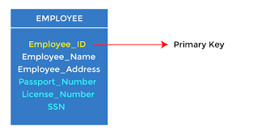
Primary Key
Primary Key is the minimal super Key.
Ideally a primary key is composed of only a single attribute.
Primary key field cannot be null.
Its attribute values are never or very rarely changed.
SQL Command
CREATE TABLE EMPLOYEE(
Employee_ID varchar (10) PRIMARY KEY,
………….);

Slide 7
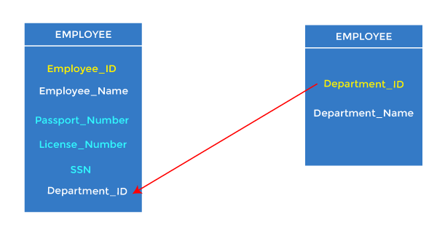
Foreign Key
A foreign key is a combination of columns with values based on the primary key values from another table.
Also known as a referential integrity constraint.
SQL Command
CREATE TABLE EMPLOYEE(
…..,
FOREIGN KEY (Department_ID) REFERENCES EMPLOYEE(Department_ID)
………);

Slide 8
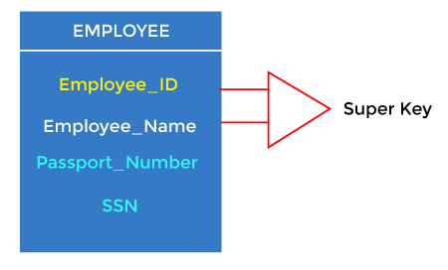
Super Key
Super key is stand for superset of a key.
A super key is a group of single or multiple keys which identifies rows in a table.

Slide 9
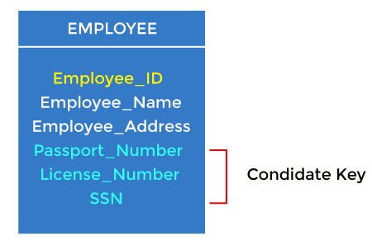
Candidate Key
Candidate keys are minimal super keys.
Are individual columns in a table that qualifies for uniqueness of each row/tuple.

Slide 10
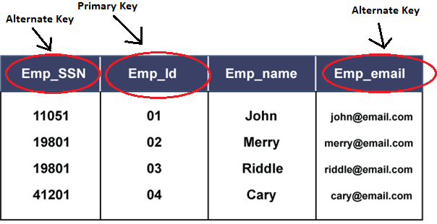
Alternate Key
An alternate is a secondary candidate key that is capable of identifying a row uniquely.

Slide 11
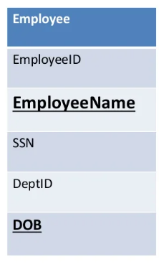
Composite Key
Two or more attributes together form a composite key that can uniquely identify a tuple in a table.
Composite Key

Slide 12
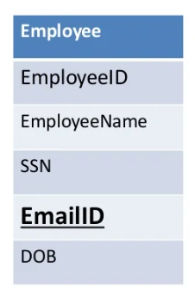
Unique Key
Unique key is same as primary with the difference being the existence of null.
Unique key field allows on value as NULL value.
SQL Command
CREATE TABLE Employee (
…..,
EmailID varchar (20) NOT NULL,
UNIQUE (EmailID)
….);
Unique

Slide 13
Conclusion
Each table must have keys, because use of keys make data highly reliable and provide several types of content like unique data and null values.

Slide 14

Thanks!

